Slide 1
12^{th Sep 2023}
Azure Synapse analytics
SQL Pools
Serverless
Dedicated Pools
Collate in SQL
Common Table Expression
Global Temporary table
Data distribution
Replicated
Round-Robin
Hash Distributed
Indexing
Notebooks

Slide 2
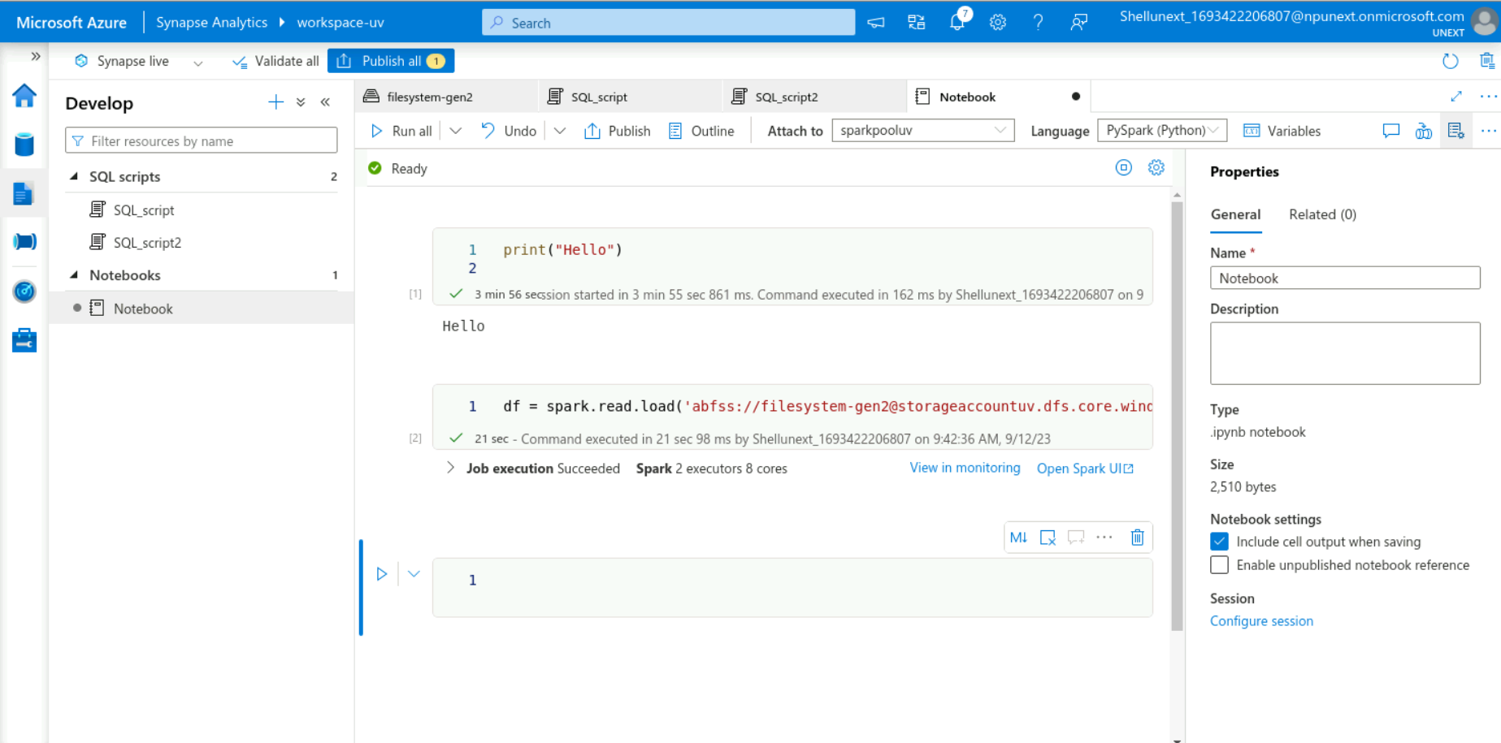
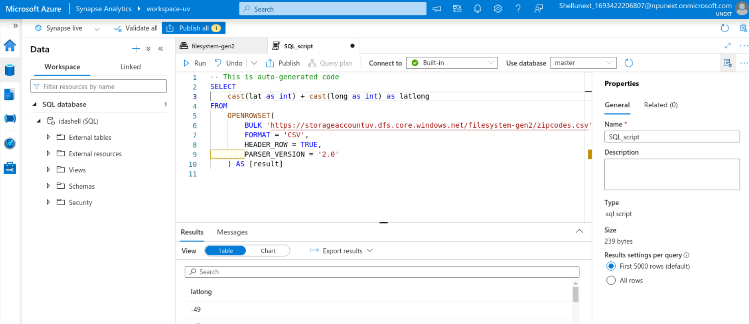
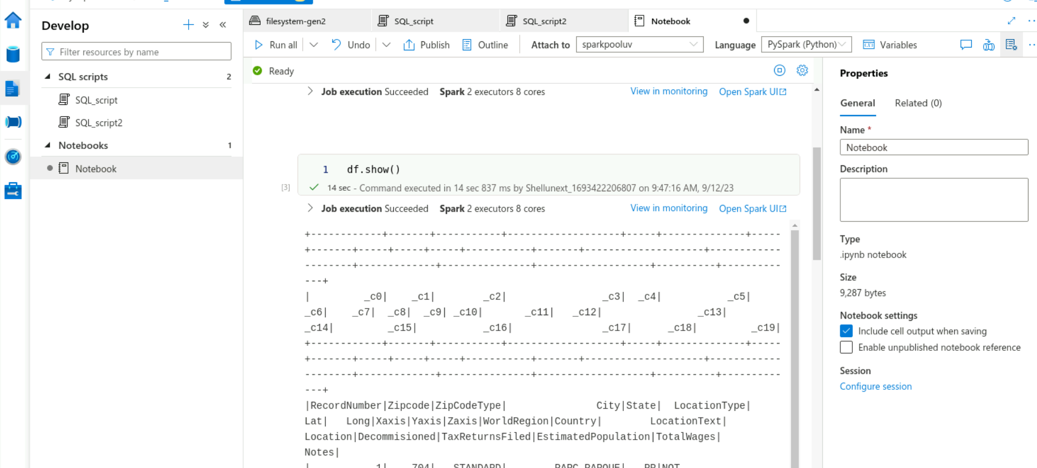
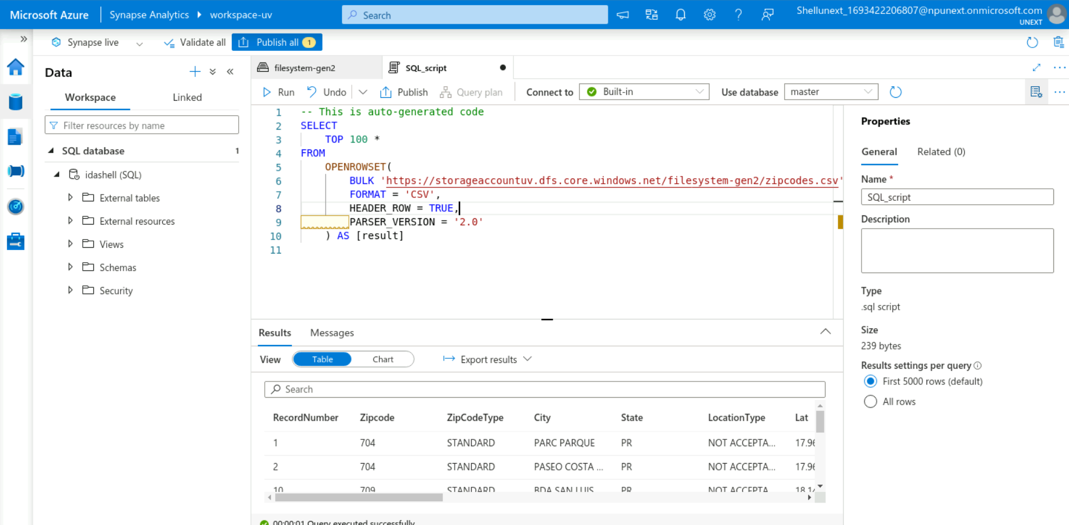

Slide 3
13th Sep 2023
PowerBI Desktop
Power Query
Loading in data
Reports
Dashboards
Parameters in PowerBI
Filtration
Visual level
Report level
Page level
Calculated columns and measures
DAX – Data analytics expression
RBAC

Slide 4
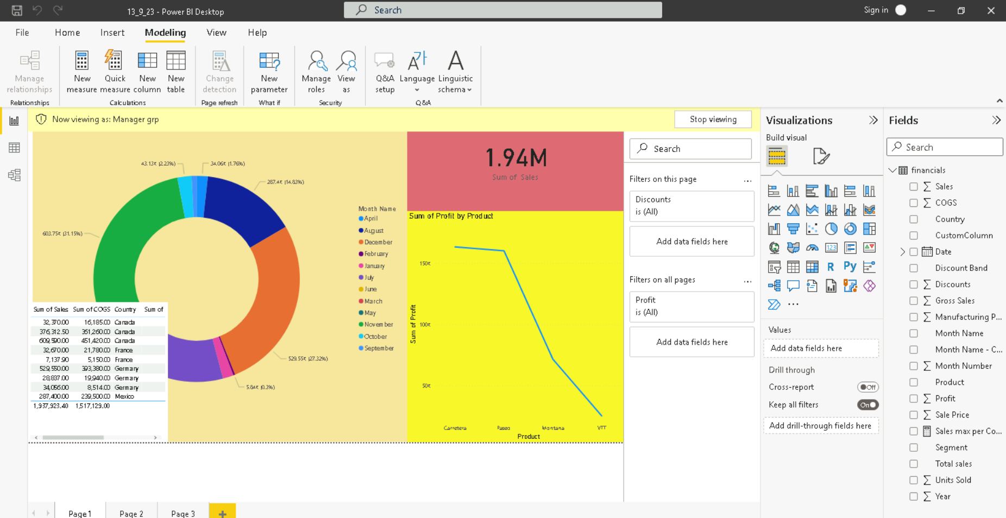
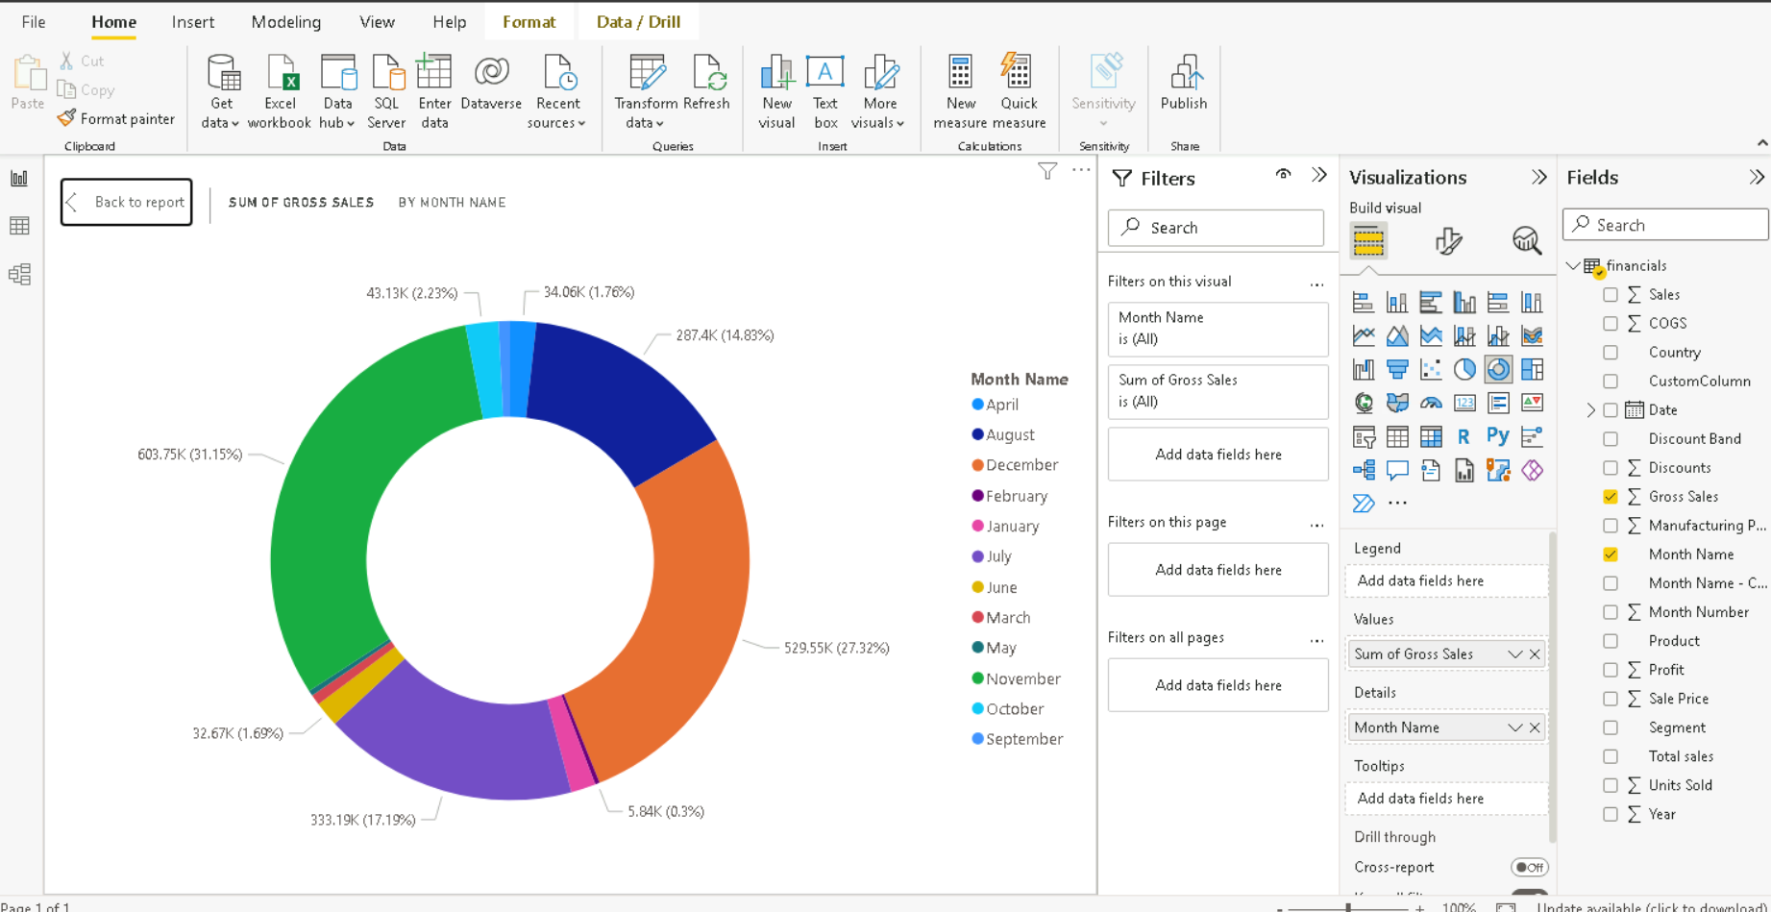
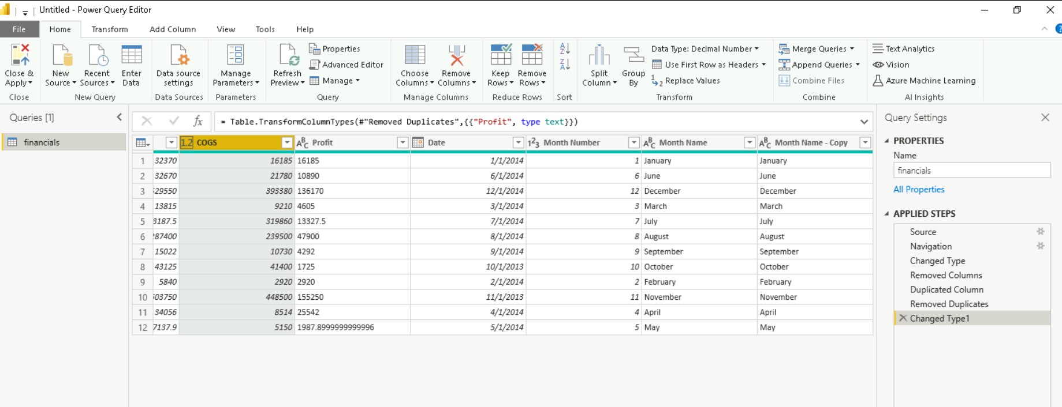

Slide 5
14th Sep 2023
Loading csv files in PowerBI
Relationship between entities
Univariant, Bivariant, multivariant
Hands on activities
Parameter
Power query editor
DAX
Filters
Slicer
Tables
Beautification
Connecting to SQL Management server

Slide 6
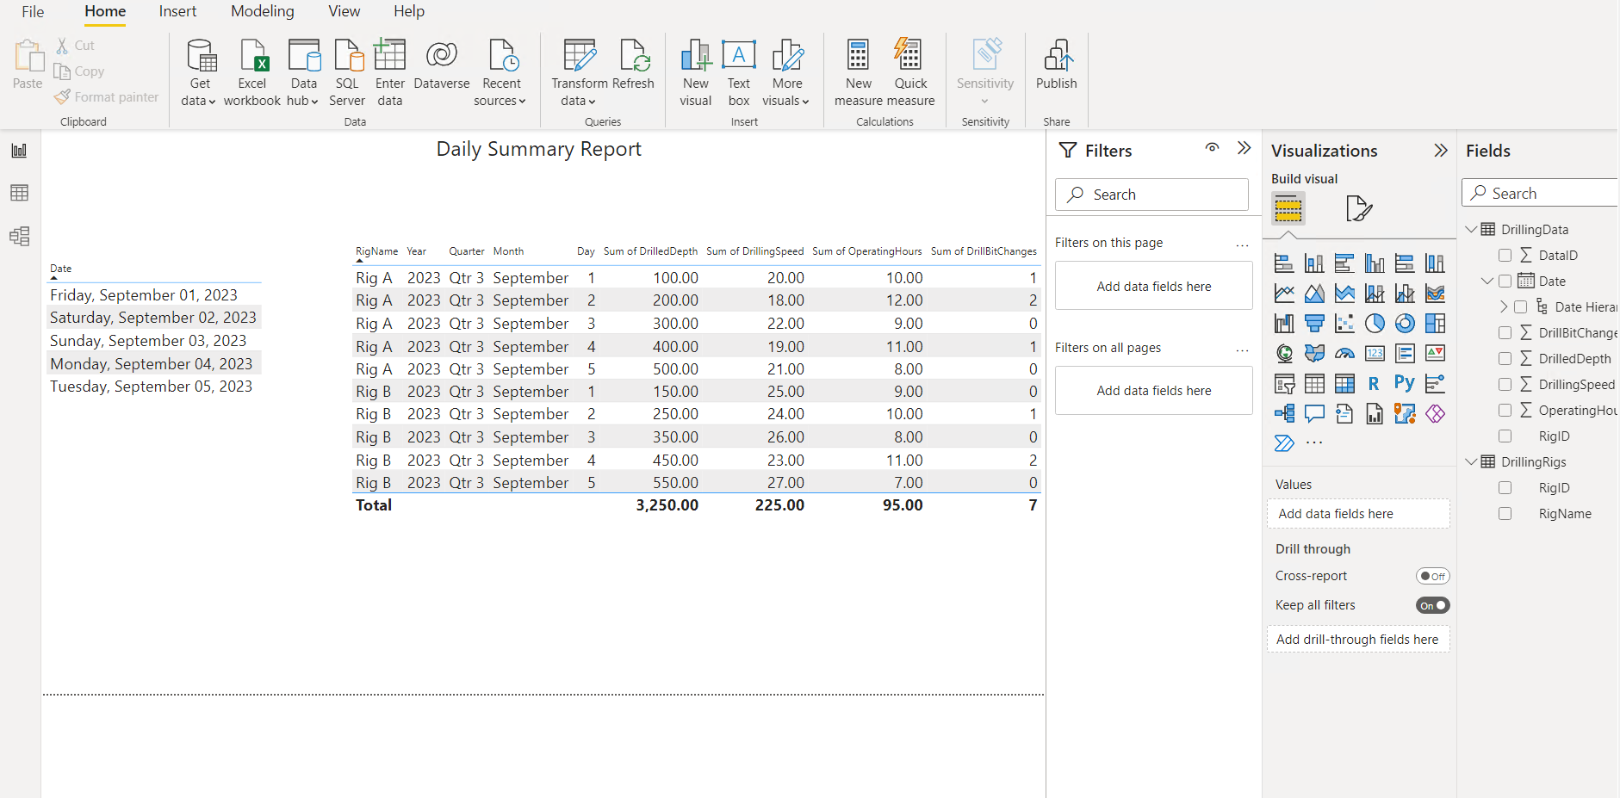
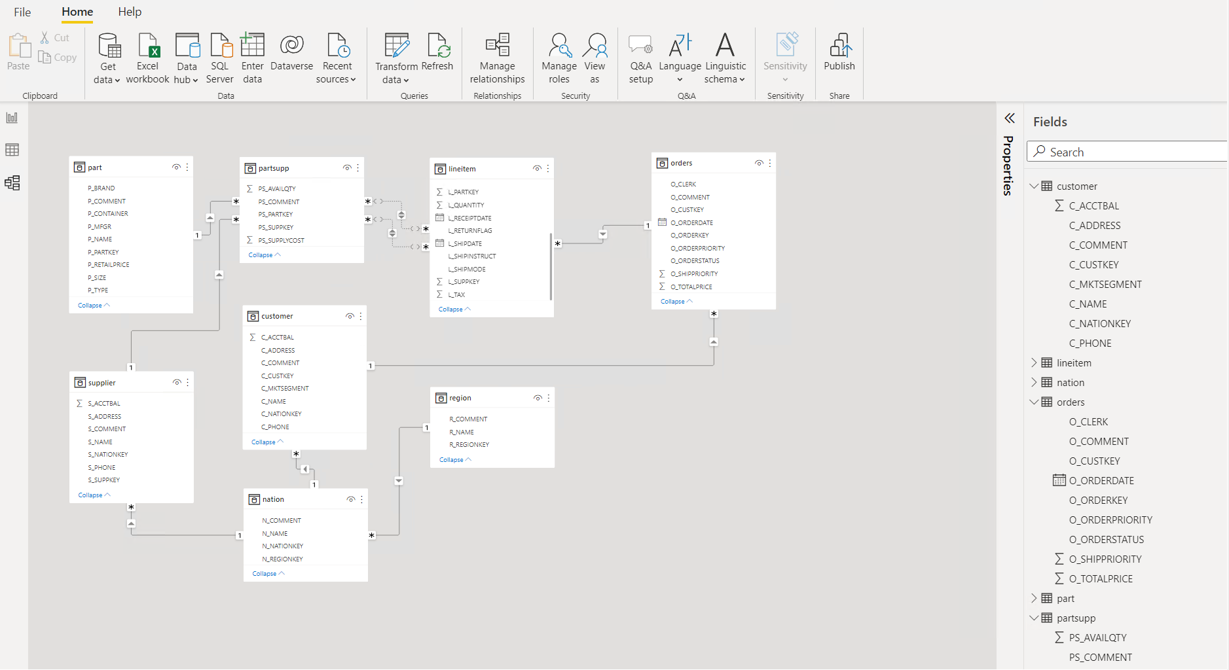
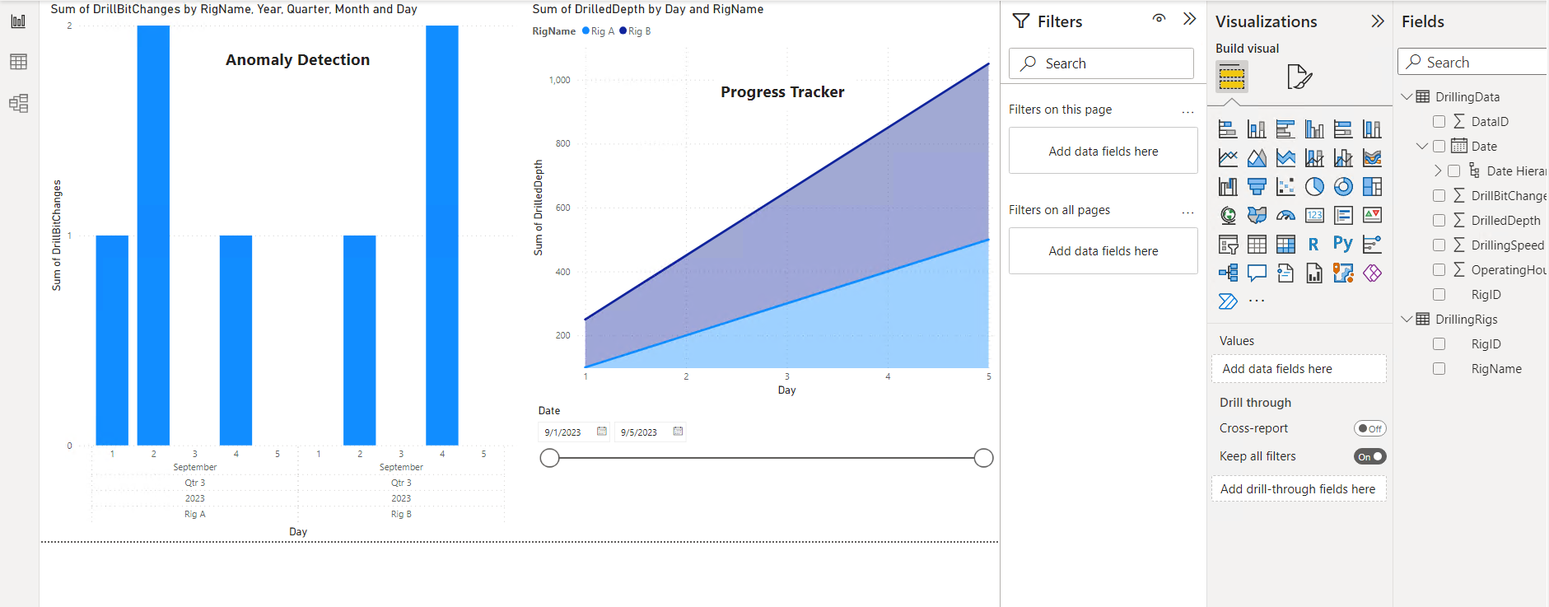

Slide 7
15th Sep 2023
Case study – PowerBI
Introduction to python
Integer
Float
String
Boolean
List
Tuple
Dictionary
Operators
Loops
Enumerations

Slide 8
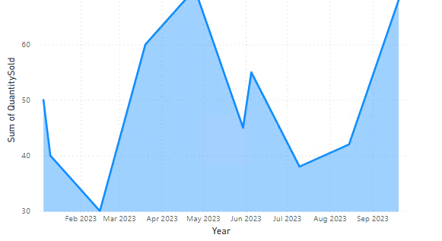
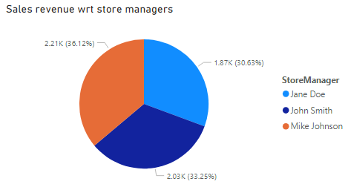
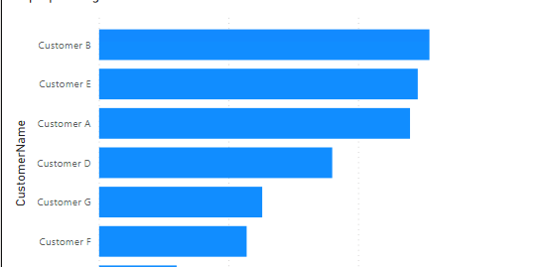
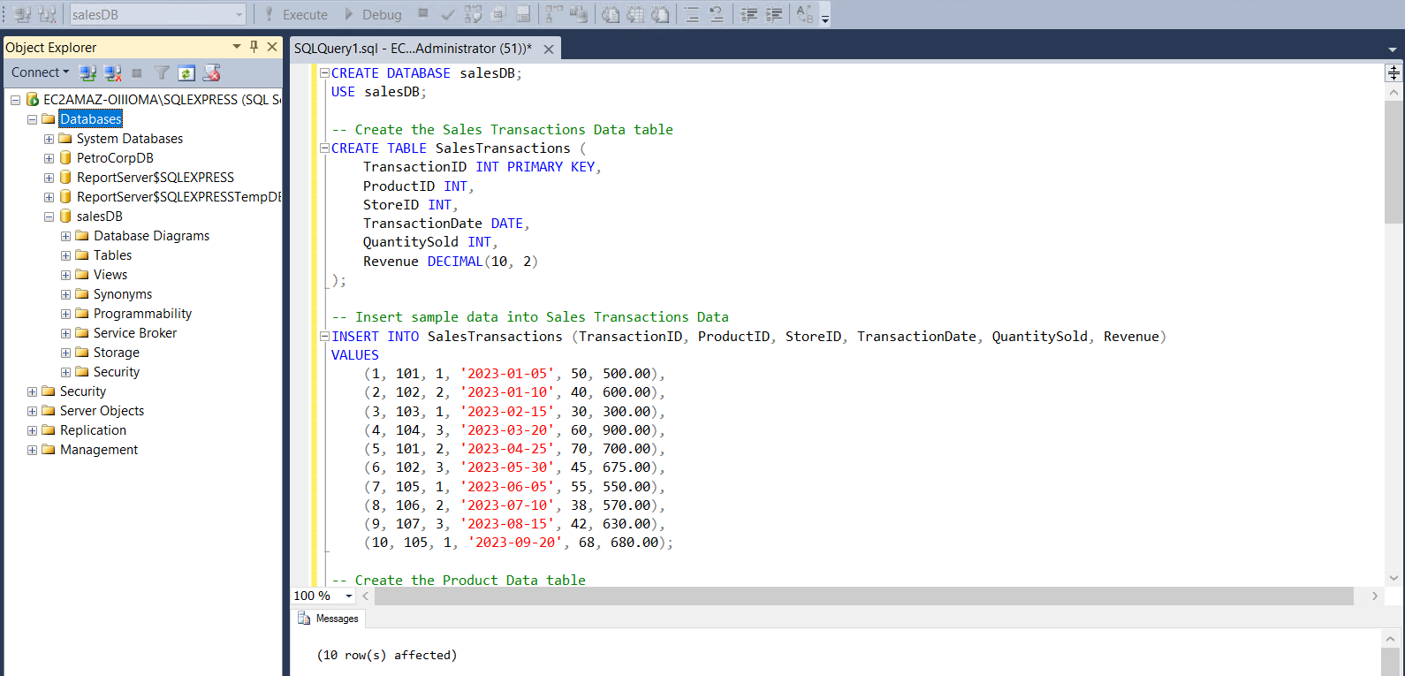

Slide 9
